Slide 1




Scientific Methodology
in
Business and Economics

Slide 2
Goals
Students differentiate methods of academic inquiry (deductive, inductive, quantitative, qualitative)
Students are able to formulate statements, hypothesis, research questions, and to differentiate between the factual and the normative
Students apply scientific referencing following a standard (MLA, Chicago, APA)
Students are aware of compliance-standards (research ethics) that apply to research and know that these standards vary according to context (countries, companies, discipline, publisher)

Slide 3
Content
Science
Research Methodology / Methods
Conducting Research
Research question
Survey of Literature
Design
Collection of Data
Analysis / Writing
Findings
Elements of a research paper
Research ethics
Backup: Other Materials

Slide 4
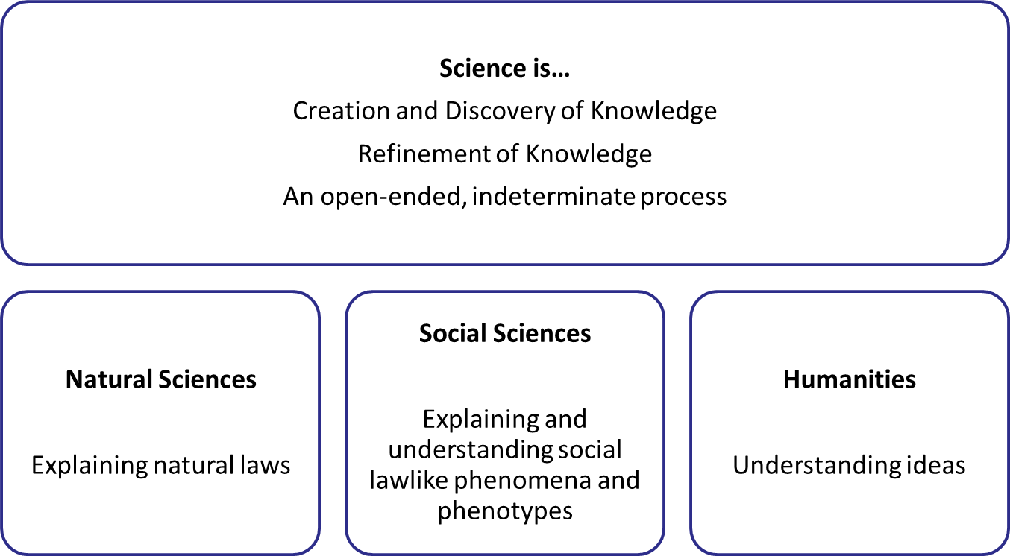
I Science

Slide 5
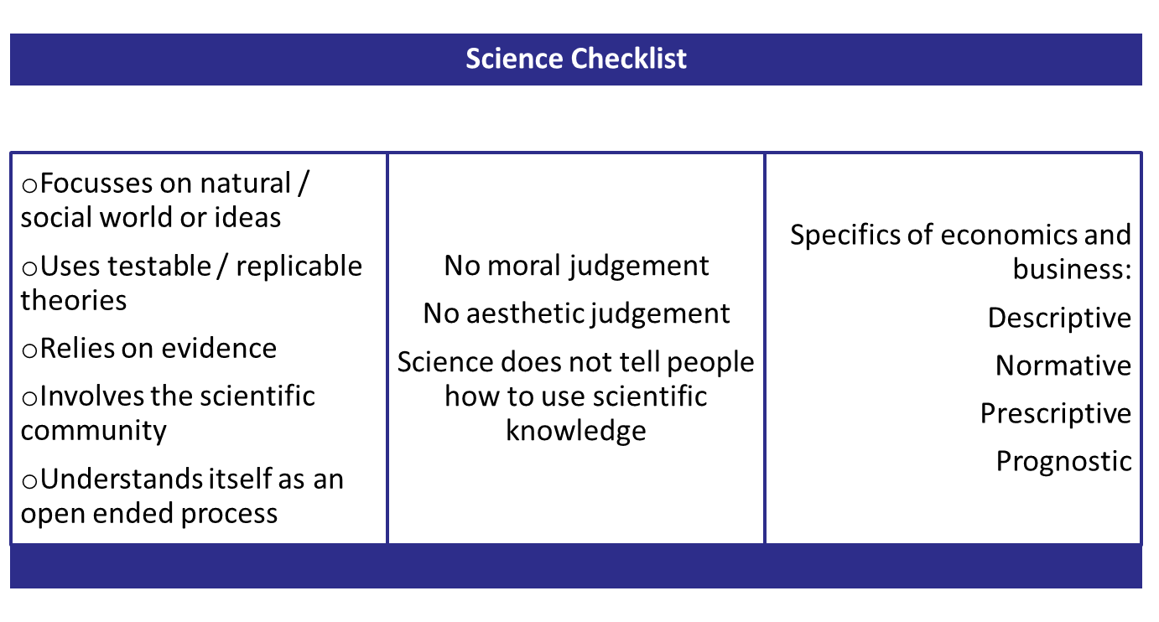

Slide 6
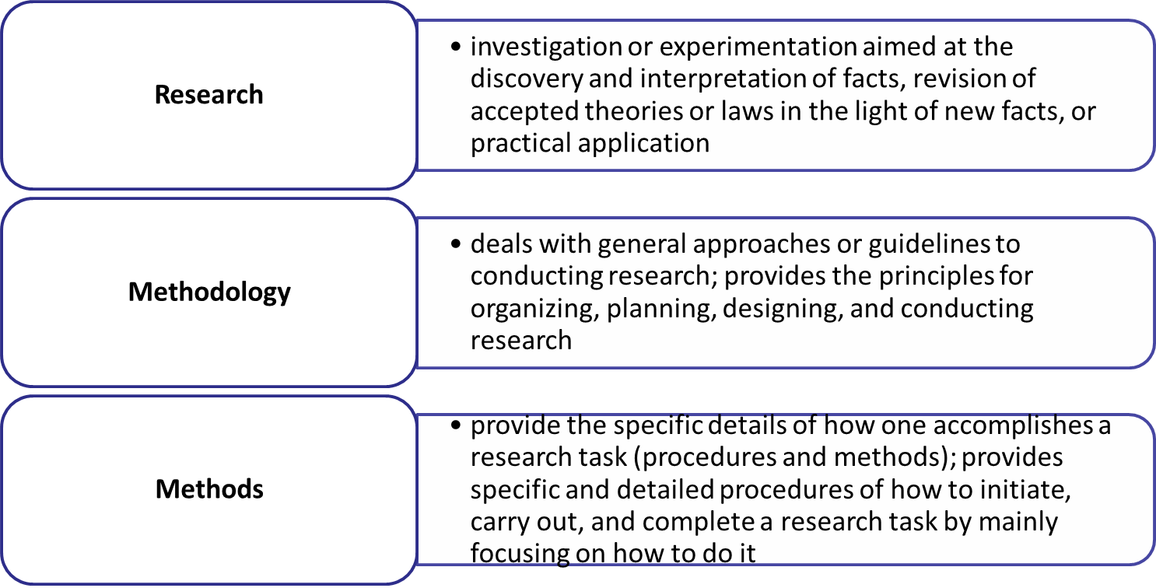
II Research Methodology / Methods

Slide 7
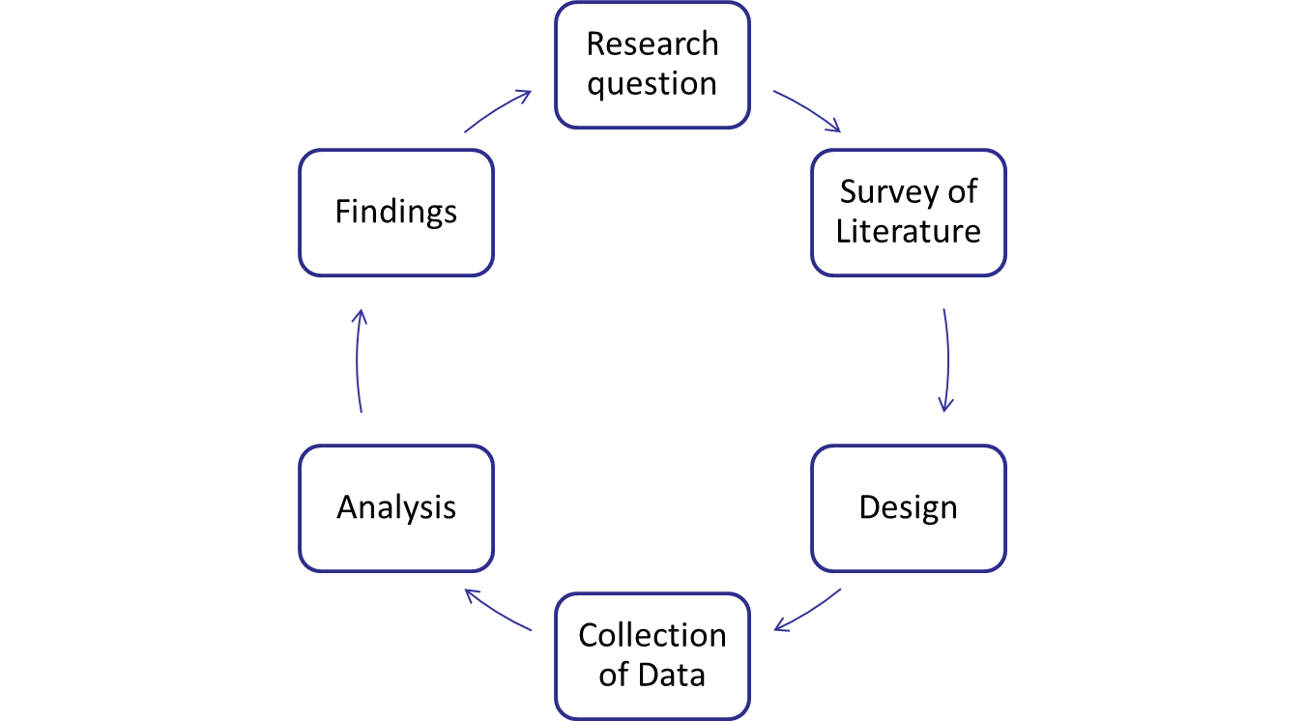
III Conducting research

Slide 8
Not focussed
Bad data
Unclear goals
Bad language
isolated
Bad Research
Means vs. ends
„opinio-nated“
No structure
No theory
No real-world link

Slide 9
objective
original
truthful
Good data
replicable
Good Research
Well written
reliable
Relevant / useful
valid
clear

Slide 10
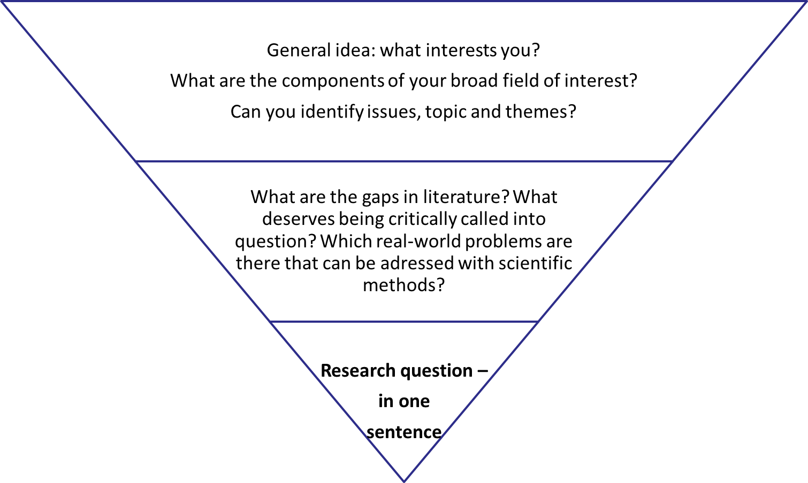
IV Research Question

Slide 11
How to incorporate the research question in your work?
Ideally: in an introduction
Define general topic
What research has already been conducted
What are gaps in literature (the main finding of the next section)
Define your specific research question – in one sentence
How will you answer your question (the main structure of the section on design)
Order of remaining paper

Slide 12
Exercises
Browse through the following articles and identify the research question as well as gaps in the literature:
  Social Media, Knowledge Sharing, and Innovation
  The Link between Management Systems and Business Performance
  Fifteen years of research in business model innovation
What is wrong with these research questions?
  How to make managers better?
  Is sales-growth the right measurement for the value-creation of a firm?
  What is the difference between the Chinese and the German exports?
Formulate a research question.

Slide 13
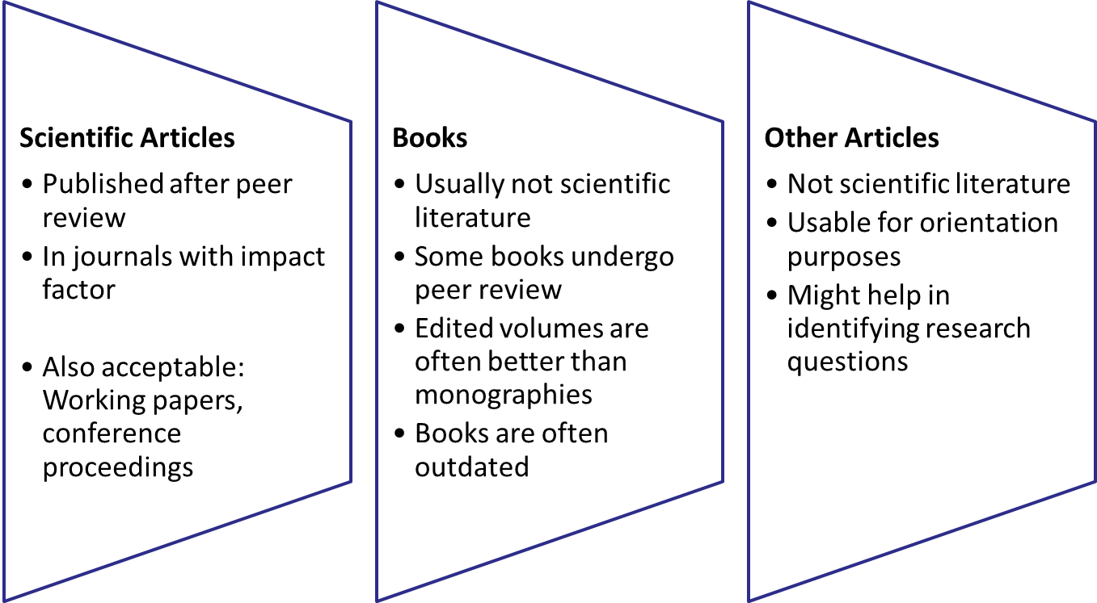
V Surveying Literature

Slide 14
The purpose of a survey of literature…
Learning about research on a given topic and answers to related research questions (read broadly)
Learning about how a body of research evolved
Displaying your understanding of research on a given topic
  Identification of important works
  Points of agreement, consensus
  Points of disagreement, controversy
  Identification of areas for further research
Providing readers with the intellectual context and some motivation for your original research (narrow focus)

Slide 15
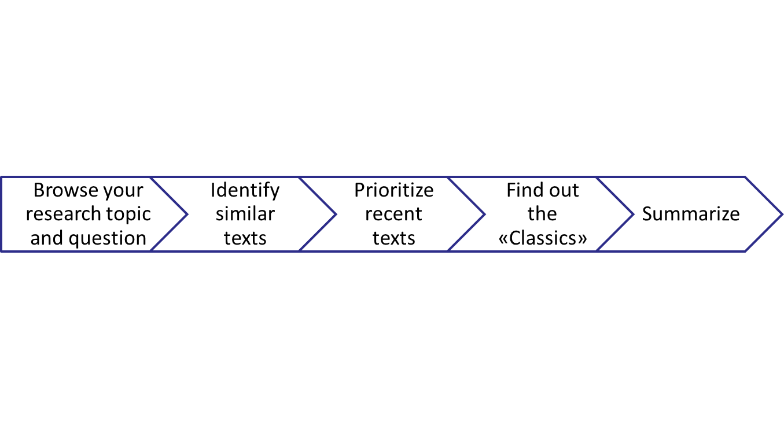
The process of a survey of literature…

Slide 16
Databanks
https://www.ebsco.com
https://www.sciencedirect.com/
https://www.jstor.org/
http://www.rfe.org/
https://scholar.google.de
Nordakademie - Bibliothek

Slide 17
How to incorporate a literature review in your work?
Ideally: a dedicated chapter / section
What does previous research say about the topic?
Each paragraph represents one study
Each paragraph represents one theme
Evaluate the Source!
Are there points of conflict in the academic literature?
Is there a gap between the real-world application and academic literature?
Summarize gaps in literature
Create a bridge between the gaps identified here, your question and the design of your research.
Caution!
  Primary literature trumps secondary literature
  Published trumps unpublished
  Scientific journals trumps any other

Slide 18
Exercises
Survey 3 articles on «disruptive innovation» and write a summary of the articles; make sure to identify one gap.
Find out the «classic» article about Rapid Plant Assessment and a more recent criticism, evaluation, or development of that text.

Slide 19
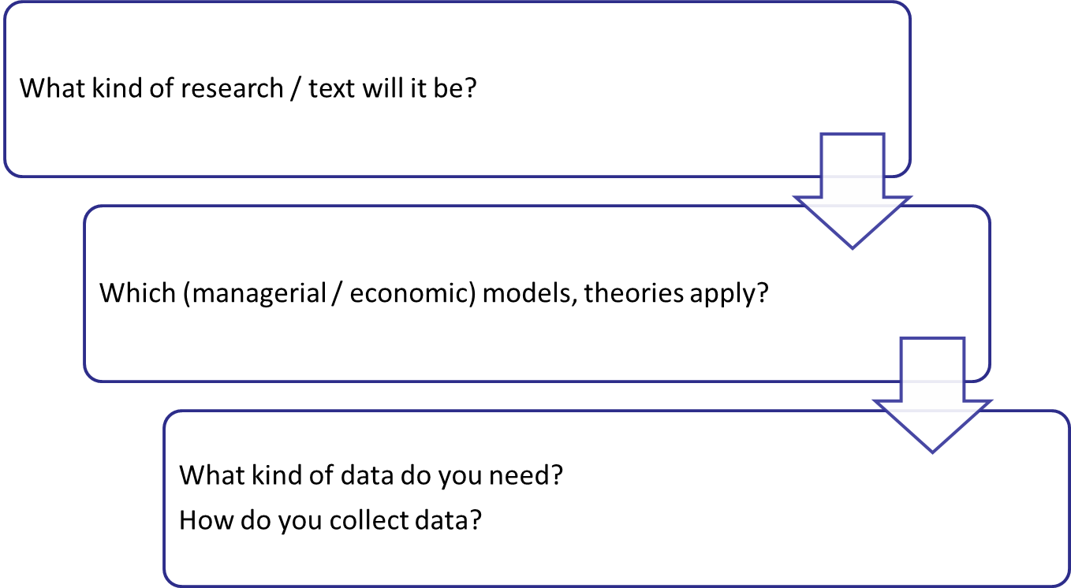
VI Research Design

Slide 20
Empirical research / text
The research question is answered in a hypothesis that is tested using data
Hypothesis is a formulation of the type
  If…, then…
  The more …, the more (less)…
In order to test a hypothesis, a relation between the first and second term of the sentence is needed
  What is to be explained – dependent variables
  What explains – independent variables
Empirical research needs data, and therefore data collection

Slide 21
Additional remarks (i) – data as descriptors
Hypothesis tests theories
Negative Test: Hypothesis is rejected → Theory is rejected
Positive test: Hypothesis cannot be rejected → Theory cannot be rejected
«cannot be rejected» does not prove «truth»
«cannot be rejected is not a demonstration
«cannot be rejected» means: the theory works as a working horse

Slide 22
Additional remarks (ii) – data as prognosis
Estimation of Parameters
The metrics of a theory can be estimated using statistical methods (past data)
Prognosis
“Cannot be rejected” theories can be metricized with estimated parameters
This leads to an abstract model
The model can lead to a statement about the future, prognosis (future data)

Slide 23
Analytical research / text
The research question is answered with a thesis
A thesis is a proposition stated or put forward for consideration, especially one to be discussed and proved or to be maintained against objections.
In order to consider a thesis, you need
  Thesis
  Argument in favor
  Fact supporting argument
  Argument against
  Fact supporting argument against
  Argument in favor that counterbalances /addresses argument against
  Fact supporting…
  …
  Conclusion

Slide 24
Comparison
The research question is answered with a comparison
A comparison addresses at least two objects by opposing them using criteria
Criteria are rules or principles for evaluating something
The comparison
  Chooses criteria
  Explaining why they were chosen
  Sometimes, criteria are weighted.
  Examines each object in light of each criterion
  Summarizes findings

Slide 25
Essay
The research question is answered with the development of a (new) theory or model
Often, essays are not scientific texts, since they have persuasive objectives
Often, essays have practical goals
Essays use examples, case-studies, etc. to make the case for something
The case made answers the research question

Slide 26
How to incorporate design in your work?
Must: at least one dedicated chapter / section
Decision about what (managerial/economic) model, or theory to use
If empirical text
Formulate Hypothesis based on theory → Collect data → Analyze data
If analytic text
Formulate thesis based on theory → Sort “pros” and “cons” including. Supporting facts → Craft a string of arguments
If comparison
Define the objects of comparison → Define criteria for comparison → (Weight criteria) → Apply the criteria to objects using data or examples
If essay
Make the point → use examples and data to persuade

Slide 27
Exercise
To which type of research / text do the following belong?
Rapid Plant Assessment
Description of Economic Models
Real Business Cycle
Corporate Entrepreneurship and Innovation

Slide 28
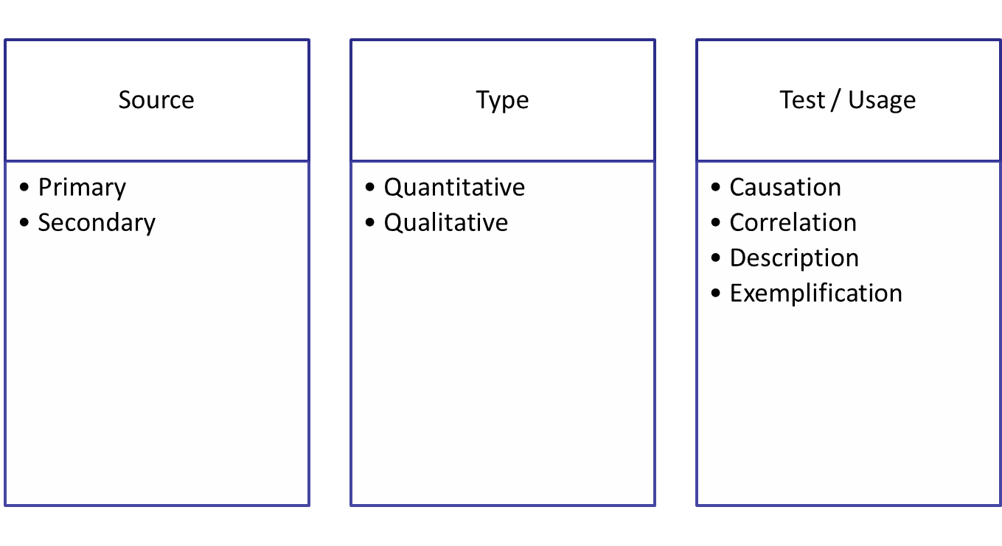
VII Collection of Data

Slide 29
How to incorporate data in your work?
Ideal: dedicated chapter / section
In the early stages of the Bachelor curriculum: stick to secondary sources
In the early stages of the Bachelor curriculum: stick to exemplification and descriptive statistics
In the early stages of the Bachelor curriculum: try to combine qualitative and quantitative research
Always understand what the data used is about
Always understand where the data used comes from
Always be aware of the source and the way data was collected
State this awareness in your paper
Data alone does not tell anything. It must be interpreted – with the help of a theory.

Slide 30
Exercise
Describe the approach to collection and use of data in the following articles:
Face and facework in conflict
Unravelling adjustment mechanisms
Financial Crisis and Policy Response

Slide 31
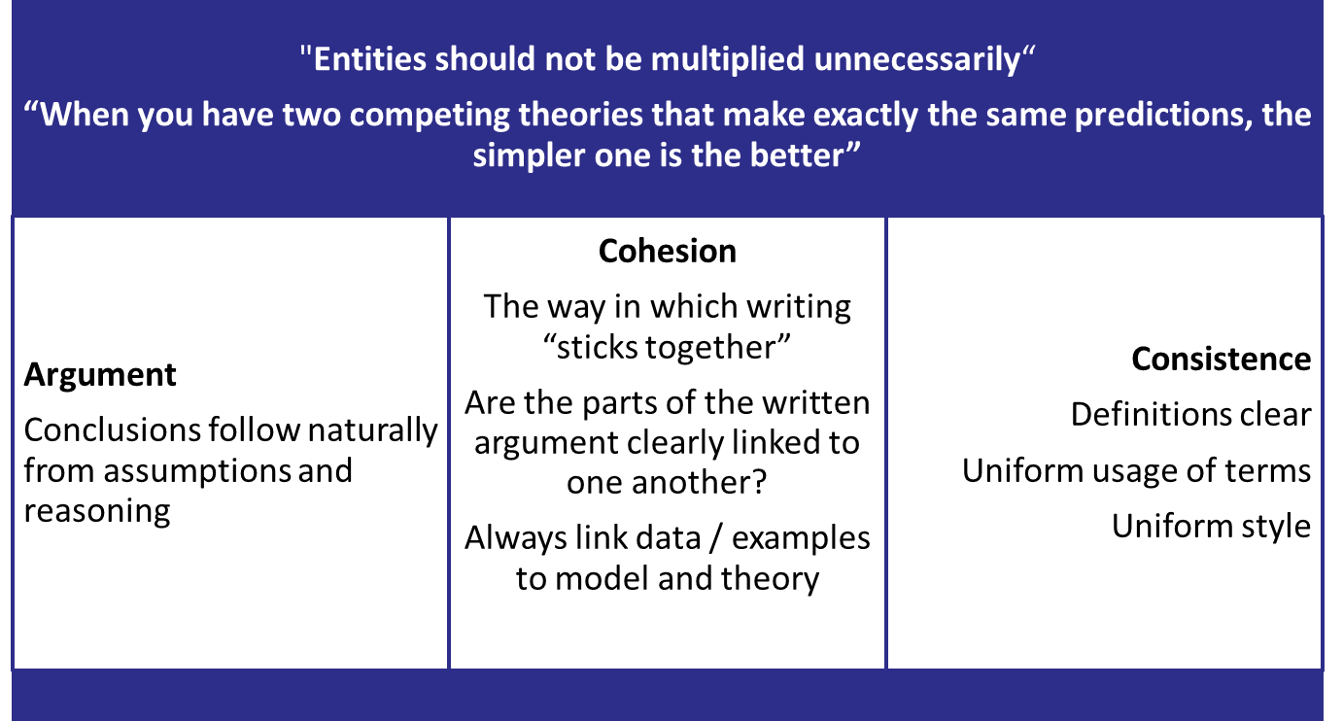
VIII Analysis / Writing

Slide 32
(Some) Mechanics of writing
Use direct quotations sparingly; paraphrase studies
Prioritize studies in the literature:
Signal importance by discussing relatively more important studies with more detail
Signal importance by noting influence on subsequent studies
Short paragraphs can help to keep writing crisp
One paragraph, one idea
Each paragraph should have a point, and only one point
Typical structure: Topic sentence: Point of paragraph, Elaboration on the point, Supporting evidence for the point
Subheadings can help to clarify structure
Imagine that you are telling a story

Slide 33
Exercise
Write a short scientific paper of 2000-3000 words on one of the topics below. Make sure to formulate a research question, define a thesis that responds to that question, review 3 scientific publications, identify one managerial or economic model, develop two arguments and two counter arguments, as well as to secure your findings.
Business models grounded in strategy are more successful than opportunistic business models.
Economics is the science that studies human behavior.
Equity-financed expansion is more secure and leads to more success than expansion financed by debt.

Slide 34
IX Findings
Restate the research question
Restate the hypothesis, thesis, criteria and objects of comparison, or the main point
Summarize your results
Did you confirm your hypothesis? Explain how so, or why not.
Weaknesses of your study
Areas for further study
No new citations, tables, or footnotes

Slide 35
X Elements of a research paper
  Title
  Author
  Abstract
  Keywords
  If requested: table of contents / table of figures / table of abbreviations
  Introduction (special status)
  Literature Review
  Theoretical Framework
  Main section
  Findings
  References
  Appendix (if any)

Slide 36
Structure of paper
Use numericals:
1, 2, 3
1, 1.1, 1.2, 1.3, 2, 2.1, 2.2, 3…
1, 1.1, 1.1.1, 1.1.2, …
Don´t go «too deep»; usually three layers more than enough; try to stick to two
The focussed the better
Strive for symmetry, ie. equally long subsections
Every table needs a reference
Every graph needs a reference
Table of contents are not necessary in short texts
Introduction and conclusion are never more than 20% of the paper
Every journal / publisher has a particular style

Slide 37
References
Usually, in-text reference
Less usually, footnote reference
Citation according to standard: APA and Harvard are well regarded in business and economics
Every journal / publisher has a particular style

Slide 38
XI Research Ethics
Honesty: Honestly report data, results, methods and procedures, and publication status. Do not fabricate, falsify, or misrepresent data. Do not deceive colleagues, research sponsors, or the public.
Objectivity: Strive to avoid bias in experimental design, data analysis, data interpretation, peer review, personnel decisions, grant writing, expert testimony, and other aspects of research where objectivity is expected or required. Disclose personal or financial interests that may affect research.
Carefulness: Avoid careless errors and negligence; carefully and critically examine your own work and the work of your peers. Keep good records of research activities, such as data collection, research design, and correspondence with agencies or journals.
Respect for Intellectual Property: Honor patents, copyrights, and other forms of intellectual property. Do not use unpublished data, methods, or results without permission. Give proper acknowledgement or credit for all contributions to research. Never plagiarize.

Slide 39
XII Backup: Materials and Texts
Introduction to Research Methods https://tinyurl.com/yay45u7u
The Craft of Research https://tinyurl.com/y8d94mvk
The Elements of Style https://tinyurl.com/js3touz
Writing to impress rather than inform https://tinyurl.com/y8x3x2g4
The Fine Art of Baloney Detection https://tinyurl.com/bo2mf49
Economical Writing https://tinyurl.com/ycnzyrhv
Practical Tips https://tinyurl.com/y9om3vw8

Slide 40
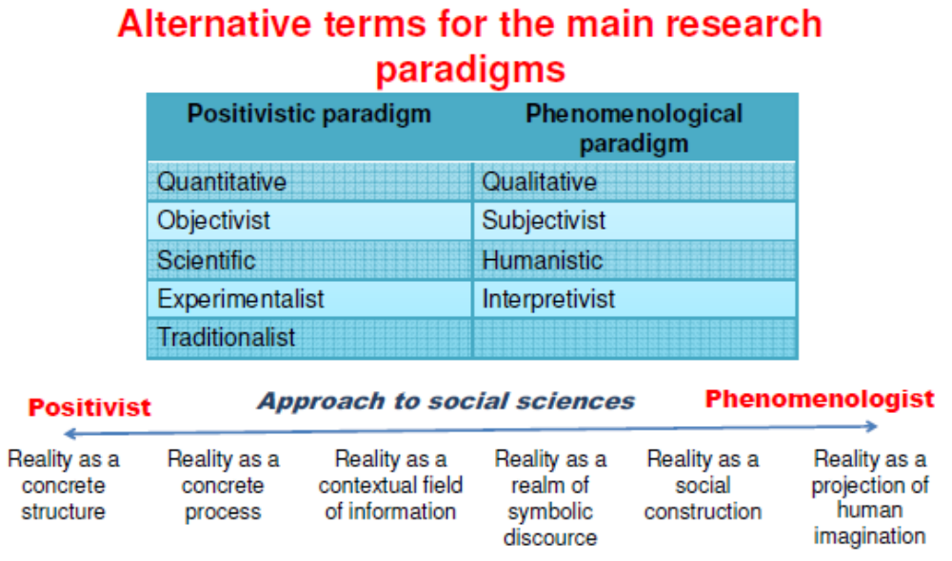

Slide 41
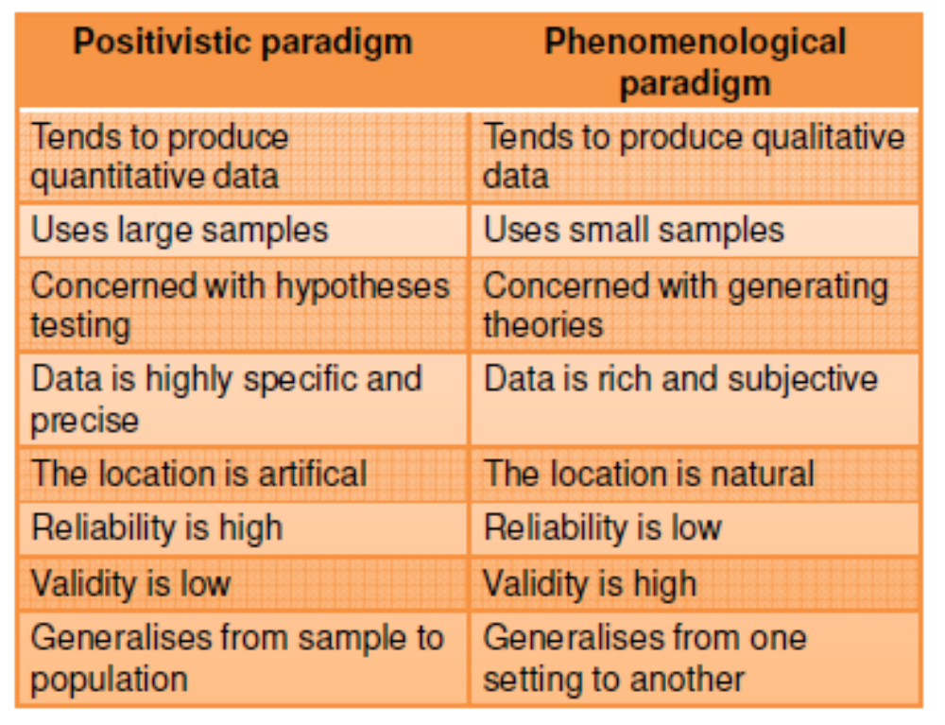

Slide 42
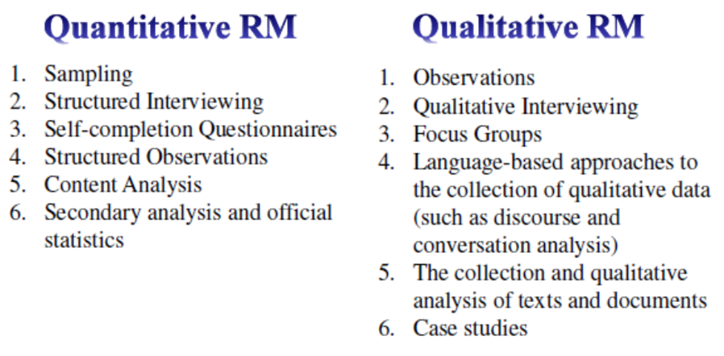

Slide 43
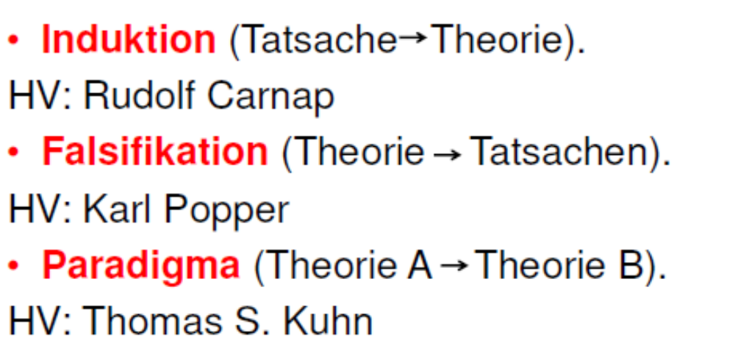

Slide 44
Caution
It is believed → i believe
It is generally believed → some buddies and I believe
It has long been known → I have no idea where this quote comes from
In my exeprience → once
In case after case → twice
In a series of cases → thrice
Preliminary experiments showed that → i hope, that
Several lines of evidence demosntrate that → it would fit our purpose
A definte trend is evident → the data is useles
While it has not been possible to provide definite answers to the question → our experiment does not work but we hope the article to be published anyway
This is correct within an order of magnitude → it´s wrong
Additionl work is required → I have nothing / I don´t understand it
This study confirms and expands previous conclusions → we have nothing new

